Slide 1
Depreciation
Process of allocating to expense the cost of a plant asset over its useful (service) life in a rational and systematic manner.
Process of cost allocation, not asset valuation.
Applies to land improvements, buildings, and equipment, not land.
Depreciable because the revenue-producing ability of asset will decline over the asset’s useful life.
Consistent with the going concern assumption.

Slide 2
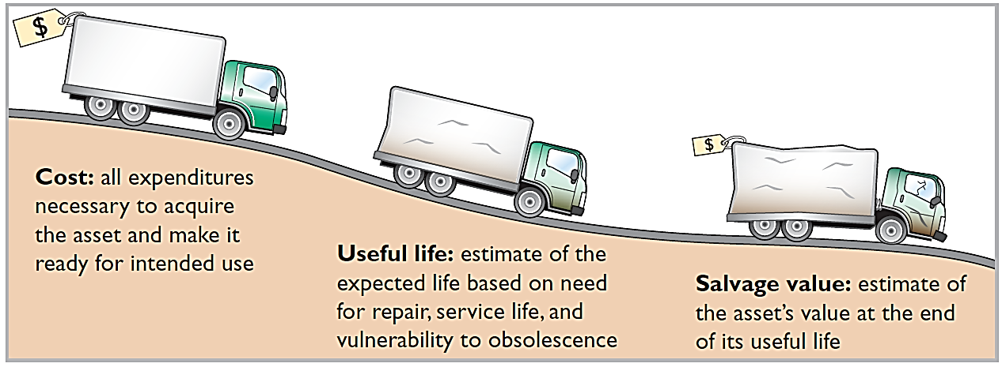
Factors in Computing Depreciation

Slide 3
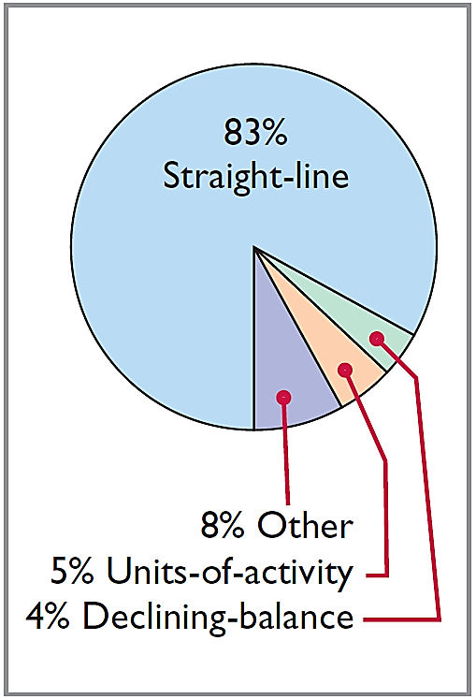
Depreciation Methods
Management selects the method it believes best measures an asset’s contribution to revenue over its useful life.
Examples include:
Straight-line method.
Units-of-activity method.
Declining-balance method.
Simple to use and good matching when the use of an asset is reasonably uniform

Slide 4
Depreciation Methods
Illustration: Barb’s Florists purchased a small delivery truck on January 1, 2017.
Cost $13,000
Expected salvage value $1,000
Estimated useful life in years 5
Estimated useful life in miles 100,000
Required: Compute depreciation using the following.
(a) Straight-line (b) Units-of-activity (c) Declining balance

Slide 5
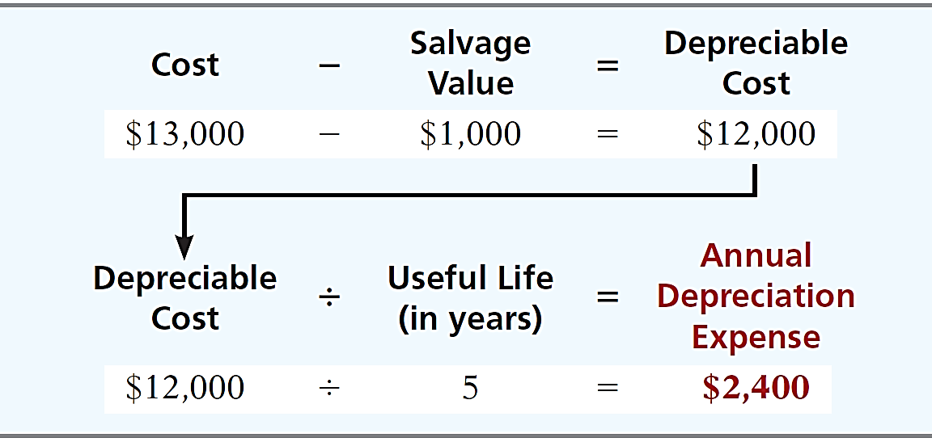
Depreciation Methods
STRAIGHT-LINE METHOD
Expense is same amount for each year.
Depreciable cost = Cost less salvage value.

Slide 6
Depreciation Methods
Illustration: (Straight-Line)
2017
$ 12,000
20%
$ 2,400
$ 2,400
$ 10,600
*
2018
12,000
20
2,400
4,800
8,200
2019
12,000
20
2,400
7,200
5,800
2020
12,000
20
2,400
9,600
3,400
2021
12,000
20
2,400
12,000
1,000
2017 Journal Entry
Depreciation expense 2,400
Accumulated depreciation 2,400
* Book value = Cost - Accumulated depreciation = ($13,000 - $2,400).

Slide 7
Depreciation Methods
Partial Year
Illustration: (Straight-Line)
Assume the delivery truck was purchased on April 1, 2017.

Slide 8
Depreciation Methods
UNITS-OF-ACTIVITY METHOD
Companies estimate total units of activity to calculate depreciation cost per unit.
Expense varies based on units of activity.
Ideally suited for use-based depreciation (factory machinery) rather than time-based depreciation (buildings and furniture).
Depreciable cost = cost less salvage value.
Alternative Terminology
Another term often used is the units-of-production method.

Slide 9
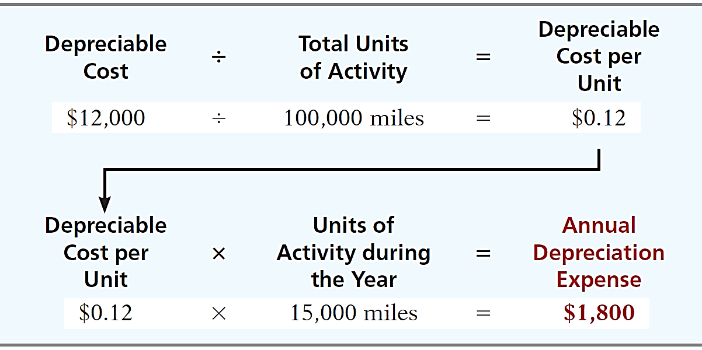
Depreciation Methods
UNITS-OF-ACTIVITY METHOD

Slide 10
Depreciation Methods
Illustration: (Units-of-Activity)
2017
15,000
$ 0.12
$ 1,800
$ 1,800
$ 11,200
2018
30,000
0.12
3,600
5,400
7,600
2019
20,000
0.12
2,400
7,800
5,200
2020
25,000
0.12
3,000
10,800
2,200
2021
10,000
0.12
1,200
12,000
1,000
2017 Journal Entry
Depreciation expense 1,800
Accumulated depreciation 1,800

Slide 11
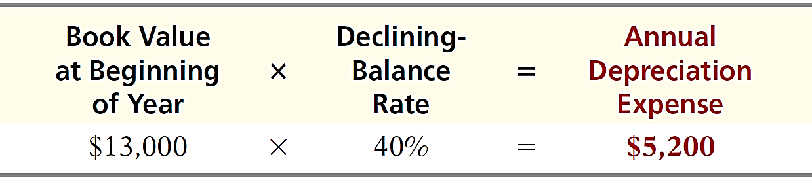
Depreciation Methods
DECLINING-BALANCE METHOD
Accelerated method – decreasing annual depreciation expense over the asset’s useful life.
Ideal for assets that lose usefulness rapidly.
Twice the straight-line rate with Double-Declining-Balance.
Rate applied to book value (not depreciable cost).

Slide 12
Depreciation Methods
Illustration: (Double-Declining-Balance)
2017
$13,000
40%
$ 5,200
$ 5,200
$ 7,800
2018
7,800
40
3,120
8,320
4,680
2019
4,680
40
1,872
10,192
2,808
2020
2,808
40
1,123
11,315
1,685
2021
1,685
40
685*
12,000
1,000
2017 Journal Entry
Depreciation expense 5,200
Accumulated depreciation 5,200
* Computation of $674 ($1,685 x 40%) is adjusted to $685.

Slide 13
Depreciation Methods
Partial Year
Illustration: (Double-Declining-Balance)

Slide 14
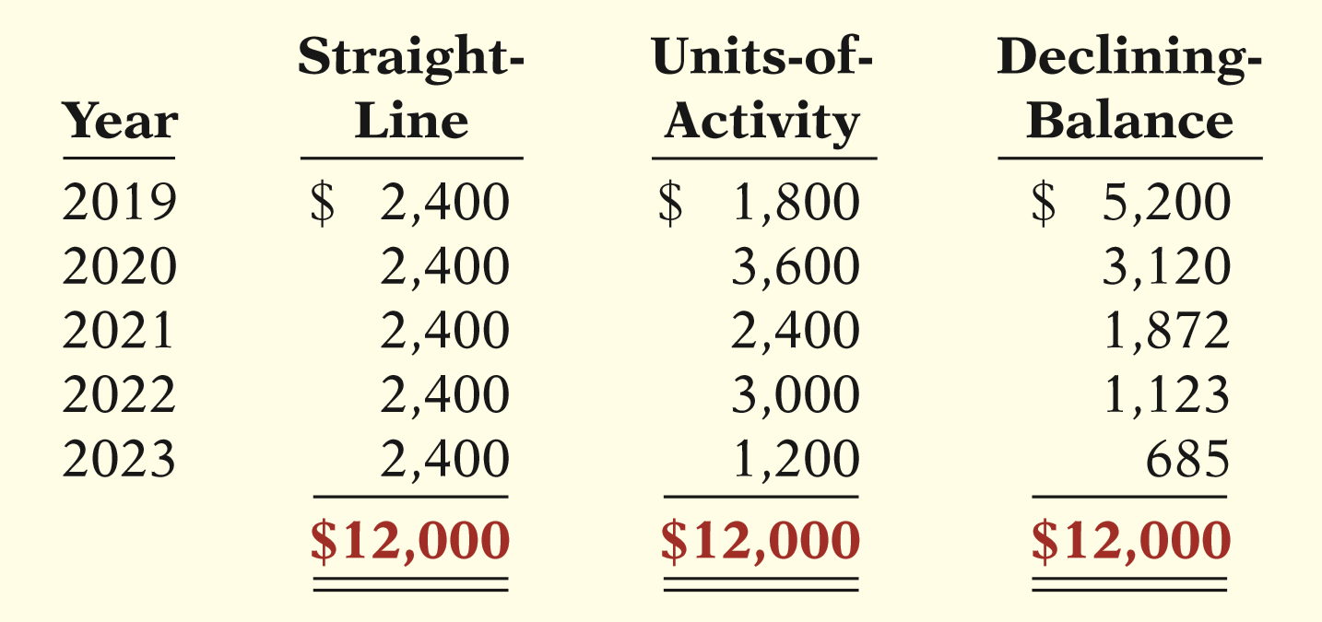
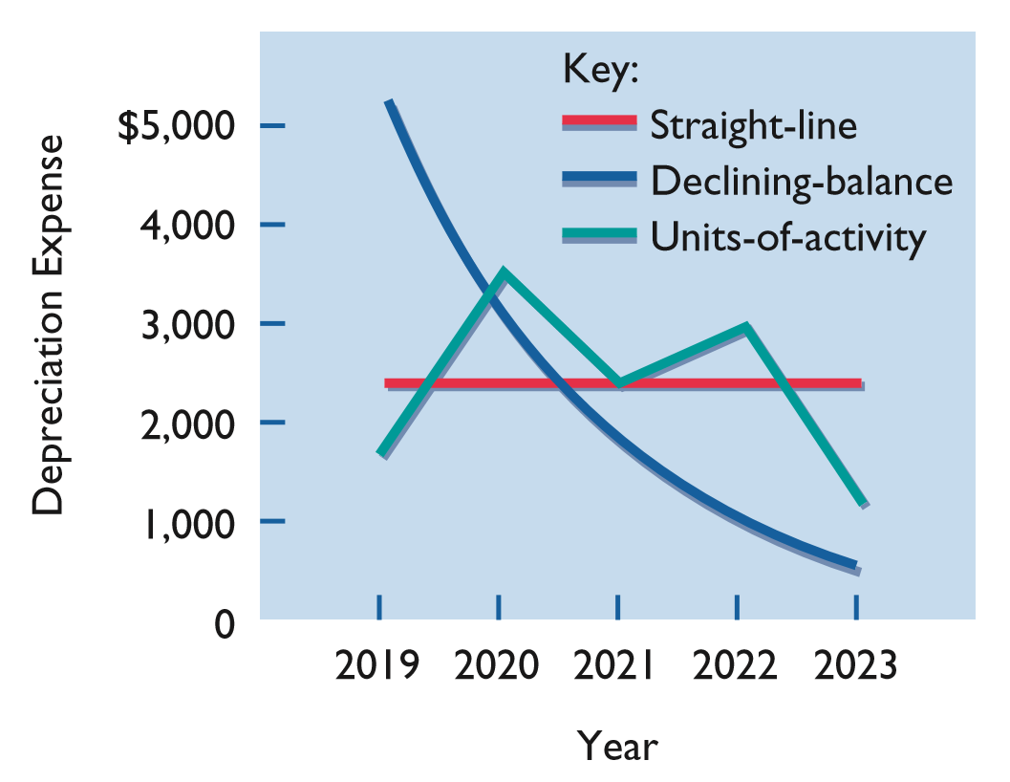
Comparison of Methods
Helpful Hint
Under any method, depreciation stops when the asset’s book value equals expected salvage value.

